Slide 1
The Dynamic Neuro-Symbolic Agent: Enhancing Arithmetic & Logic in Small Language Models
Bridging the Gap Between Natural Language and Symbolic Precision.

Slide 2
The Problem – The "Generalist" Flaw
The Hallucination Trap: Large Models are probabilistic next-token predictors. They don't "calculate"; they "guess" the next number.
Result: High error rates in multi-step arithmetic and constraint satisfaction problems (e.g., Zebra Puzzles).
The "Alignment Tax": Fine-tuning a model to be "chatty" often degrades its reasoning capabilities.
Privacy & Cost: Reliance on massive models (GPT-4, Gemini) requires sending sensitive data to the cloud and incurring high API costs.

Slide 3
Can a SLM perform better than larger models in specific, high-value tasks?
Integrating a Small Language Model (Qwen-4B) with deterministic symbolic tools (Z3 Solver & Python Calculator) to eliminate hallucination in logic and math.

Slide 4
The Solution – Neuro-Symbolic Architecture
The Neuro (The Translator): A Small Language Model (Qwen-4B) handles the linguistic complexity. Its only job is to understand the user's intent and parse it into a structured schema (JSON).
The Symbolic (The Executor): Deterministic algorithms handle the actual logic.
Math: A Python SafeEvaluator using Abstract Syntax Trees (AST) for arithmetic.
Logic: The z3-solver for constraint satisfaction problems.
Key Advantage: The LLM never "does the math." It simply sets up the equation for a machine that cannot be wrong.

Slide 5
System Architecture (Model A)
Component 1: The Tool Agent Class
A custom Python class that intercepts user queries and manages the conversation loop.
It forces the SLM to output JSON only, stripping away the "fluff".
Component 2: The Logic CSP Solver
For complex logic (like the Zebra Puzzle), we don't ask the AI to "think."
We ask the AI to extract constraints (e.g., same_house(Natalie, Black_Dress)).
These constraints are fed into z3, a theorem prover, which mathematically guarantees a valid solution or proves none exists.
Component 3: Dynamic Adapter
The system uses peft and AutoModelForCausalLM to load a lightweight 4B parameter model on a single T4 GPU.

Slide 6
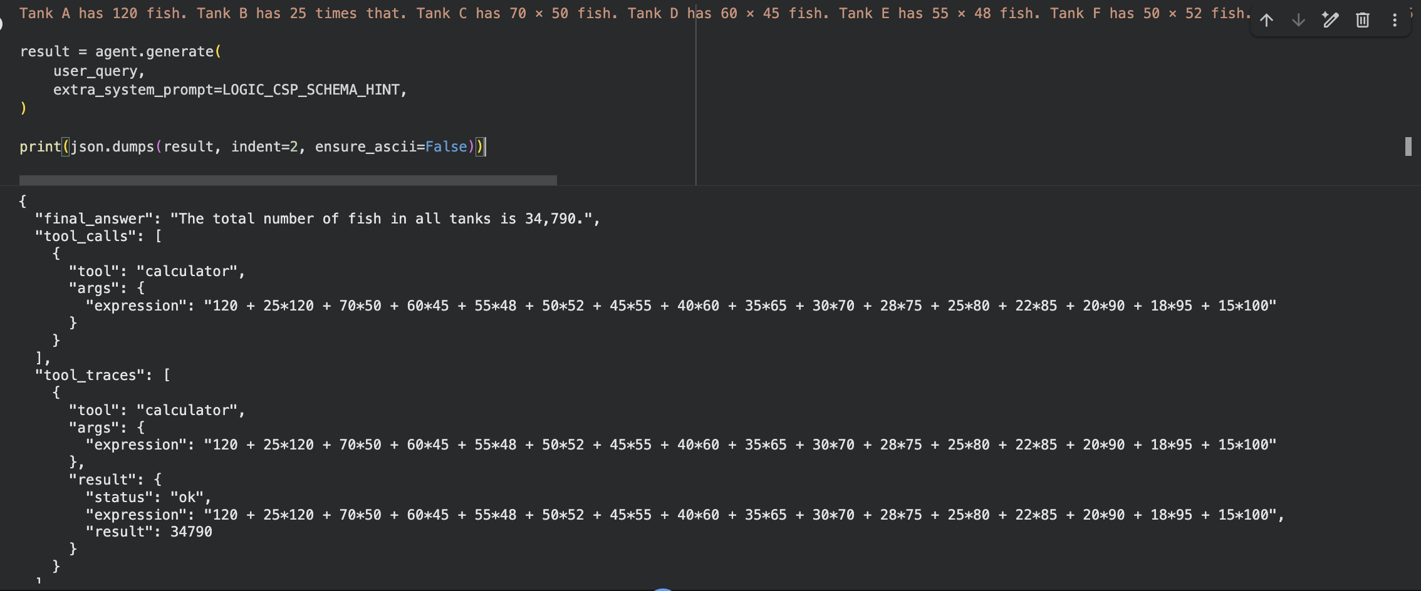
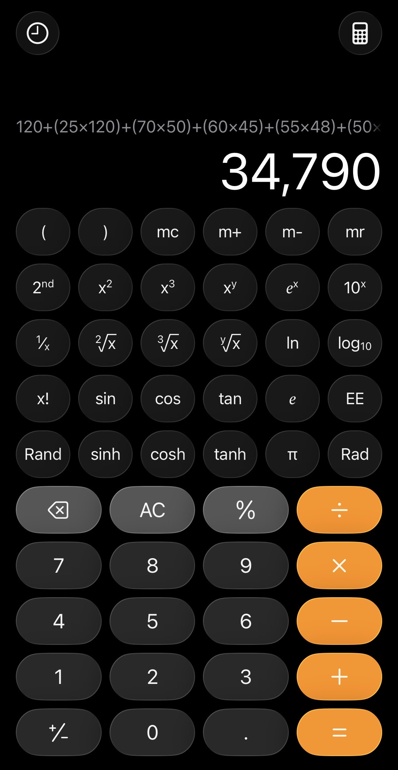
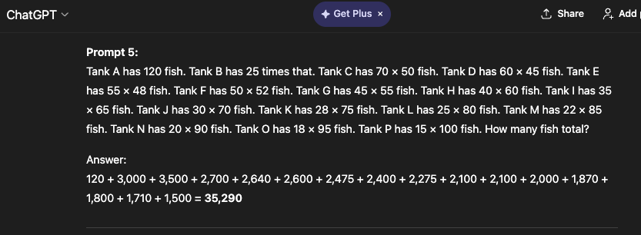
Prompt- Tank A has 120 fish. Tank B has 25 times that. Tank C has 70 × 50 fish. Tank D has 60 × 45 fish. Tank E has 55 × 48 fish. Tank F has 50 × 52 fish. Tank G has 45 × 55 fish. Tank H has 40 × 60 fish. Tank I has 35 × 65 fish. Tank J has 30 × 70 fish. Tank K has 28 × 75 fish. Tank L has 25 × 80 fish. Tank M has 22 × 85 fish. Tank N has 20 × 90 fish. Tank O has 18 × 95 fish. Tank P has 15 × 100 fish. How many fish total?

Slide 7
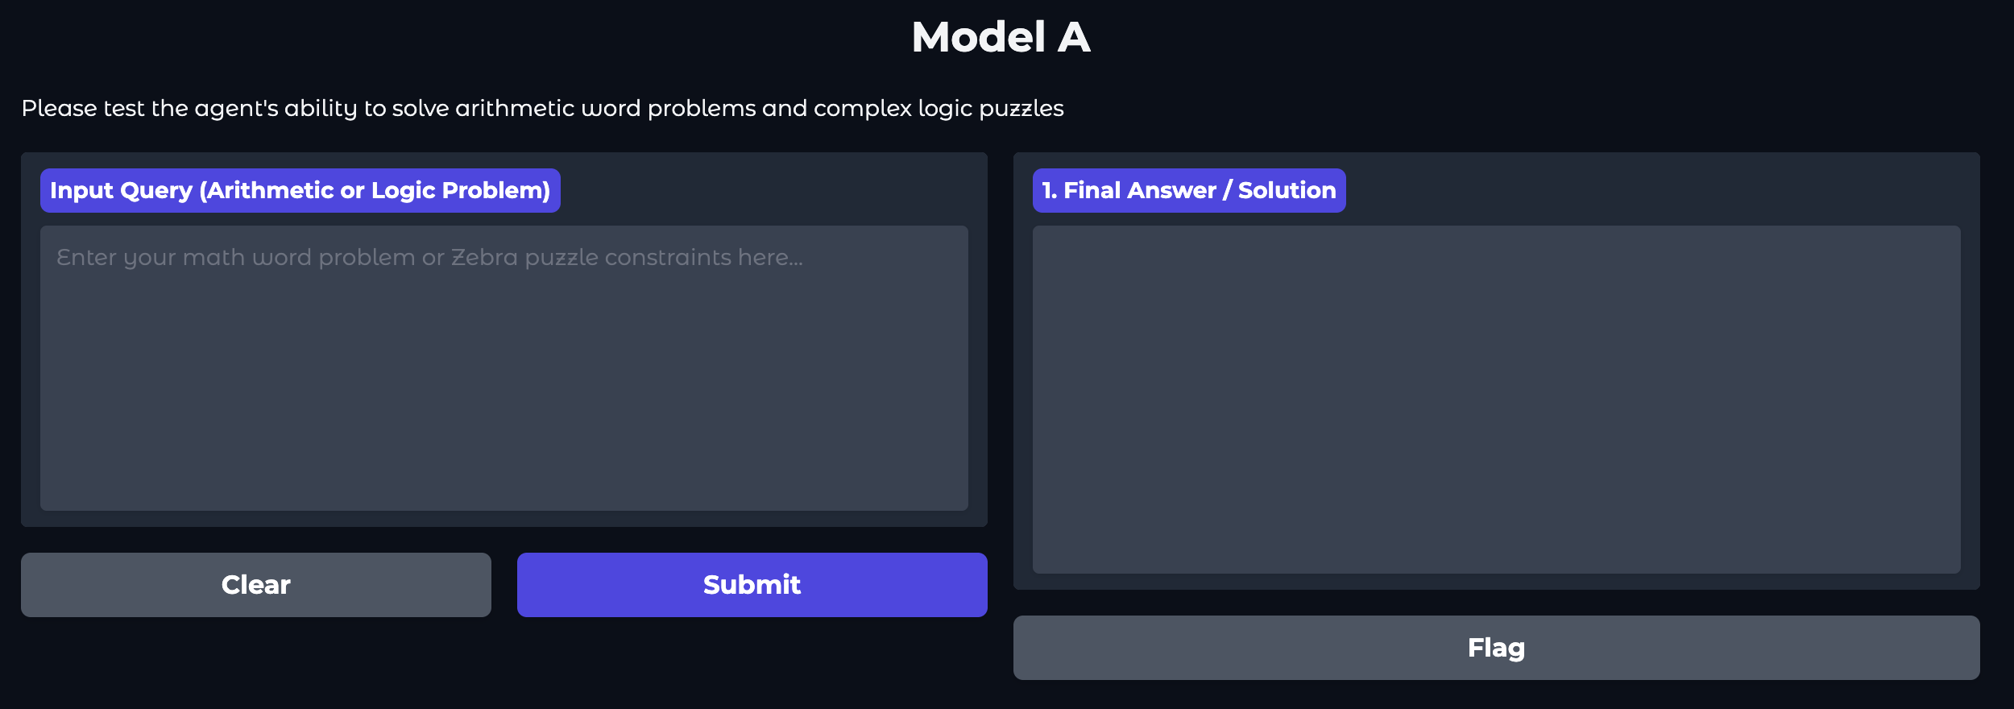

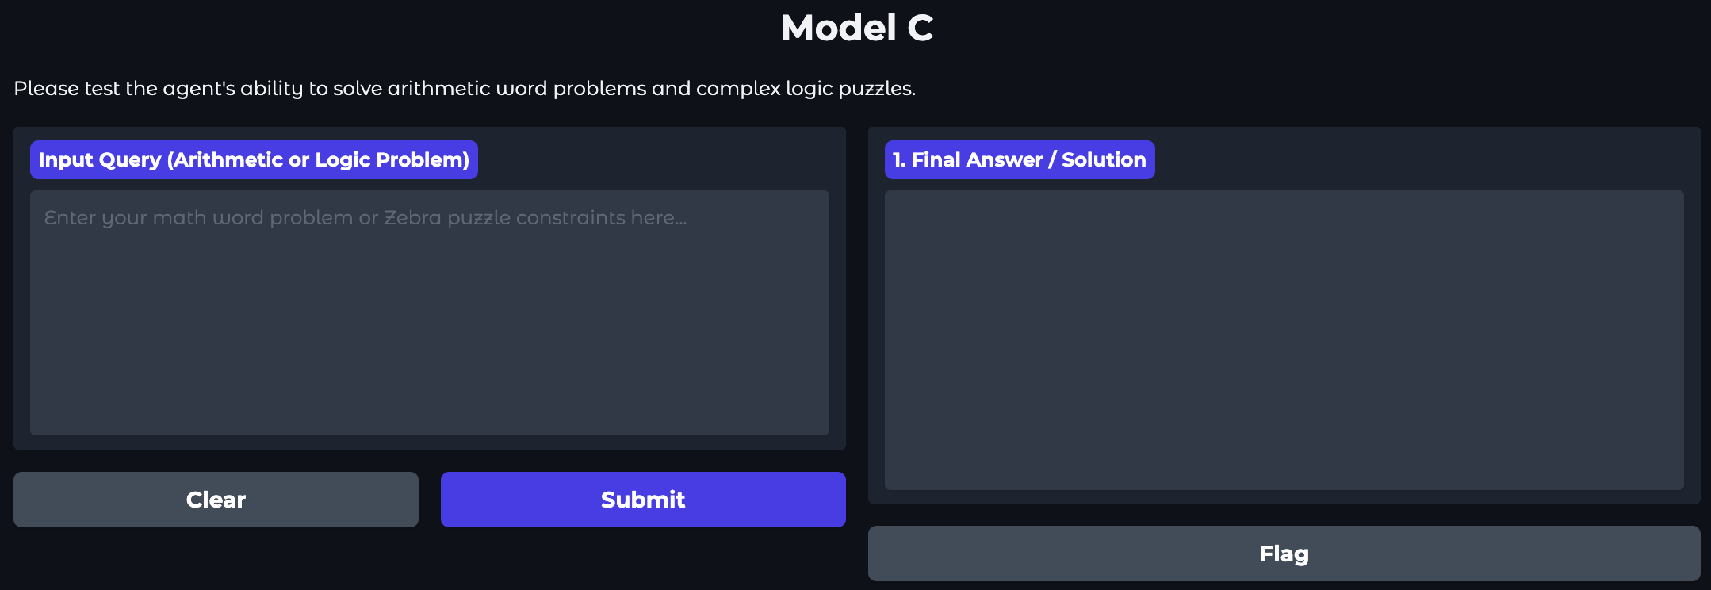
Experimental Design – The Blind Test
To validate our approach, we conducted a blind A/B/C test with users.
The Setup: Three identical Gradio interfaces. Users did not know which model was which.
The Lineup:
Model A (Ours): Local Qwen-4B (T4 GPU) + Z3 Solver. (The Neuro-Symbolic Agent).
Model B (Baseline): Base Qwen (via API). A raw SLM with no tools. Represents the "standard" local AI experience.
Model C (Reference): Qwen-2.5-72B (via API). A massive state-of-the-art model. Represents the "Gold Standard" upper bound.

Slide 8
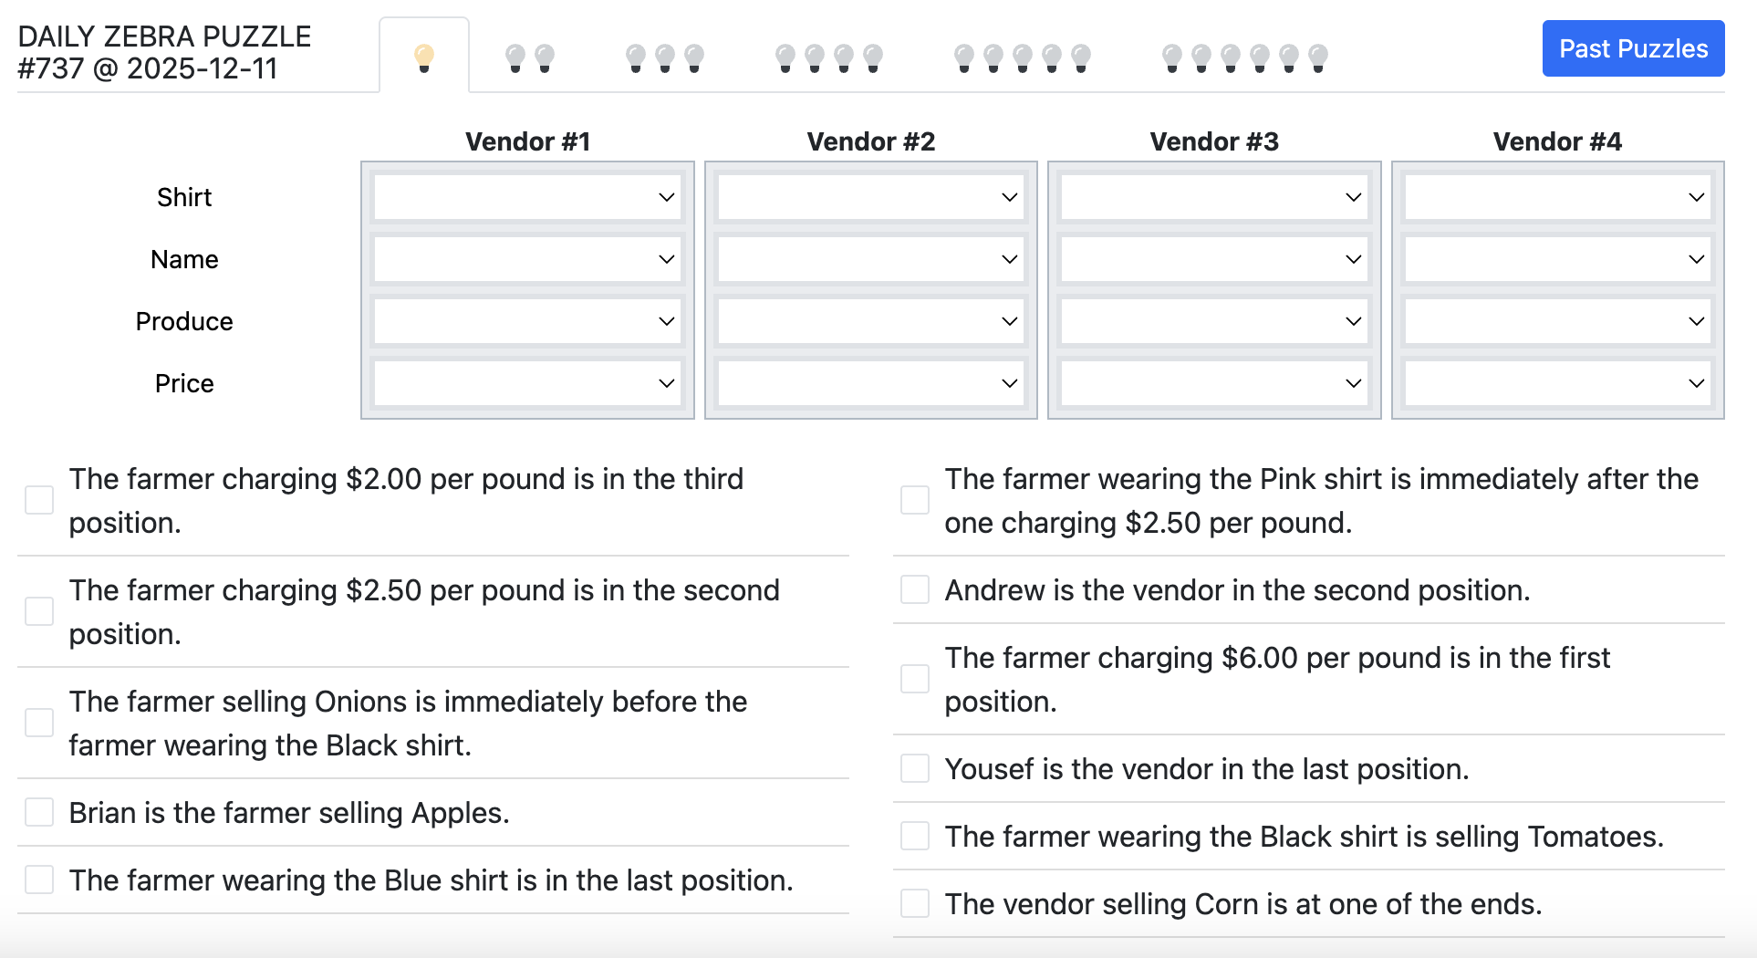

Slide 9
Conclusion & Value Proposition
Why this matters
Efficiency: We approached "72B-level" accuracy on logic tasks using a 4B parameter model. This reduces computational requirements by over 90%.
Reliability: By offloading logic to symbolic tools, we eliminated the "black box" unpredictability of LLMs for these specific tasks.
Privacy: This entire architecture runs locally on a standard GPU (Colab T4), proving that enterprises can deploy Subject Matter Expert AIs without exposing proprietary data to public APIs.
Explainability: The tool use paradigm segments the process of “reasoning” by outsourcing heavy logic tasks to concrete code that can inspected and validated
Final Takeaway: The future of specialized AI isn't just bigger models; it's smarter architectures that combine the flexibility of language models with the certainty of code.

